Slide 1
C372 Payment Technologies
Graded Assignment

Slide 2
Graded Assignment
The SA is in the form of Graded Assignment(Parts 1 and 2).
This is a team assignment.
Milestone submissions and checks
There will be a F2F presentation in week 13
If you have a valid LOA on the presentation date, please inform your lecturer to reschedule.

Slide 3
IMPORTANT
This assignment is a TEAM assignment.
Class time will be allocated to work on GA
However, teams should continue to work on the GA at their own time to improve on their work
Read through the entire document before you begin.

Slide 4
IMPORTANT
If you need to clarify any points in the assignment or think there is an error, speak to your lecturer.
You may ask questions to clarify concepts just like in the regular class, but the logic and code for the assignment should come from you, NOT your lecturer.
Your lecturers will NOT debug your code or tell you what to code.
You MUST be prepared to explain specific parts of the code, the logic behind your code, and modify the program during the presentation

Slide 5
IMPORTANT
Download the necessary documents from POLITEMALL
C372 Graded Assignment
C372 Graded Assignment Briefing
C372 Graded Assignment Report – Team X
C372 Individual Declaration of Compliance - STUDENTID - STUDENTNAME
C372 Individual Graded Assignment AI Interaction Journal - STUDENTID – STUDENTNAME
C372 Individual Graded Assignment AI Interaction Journal - SAMPLE

Slide 6
IMPORTANT
Start on your assignment as soon as possible
As we go through the lessons, you are expected to progressively add on to your assignment.
The graded assignment is split into 2 parts.
Part 1: Weeks 1 – 7
Part 2: Weeks 8 – 12

Slide 7
Team Presentation
You MUST be prepared to explain any part of the deliverables submitted and modify code during the presentation
This includes:
Presentation and Prototype
Project Report
All project source code files (Includes JavaScript, CSS, EJS, images and any libraries used, e.g. bootstrap)
DB schema SQL scripts

Slide 8
Use of AI tools
Students are permitted to use AI tools (e.g., ChatGPT, GitHub Copilot) to support their work for this assessment. However, any use of AI-generated content must be clearly acknowledged during the project presentation.
Students must indicate:
The AI tool(s) used
The input prompts provided
Which parts of the code or content were generated or assisted by AI
How the generated responses were adapted or integrated into the work
Failure to provide acknowledgement of the use of the AI tool(s) is tantamount to plagiarism and should be dealt with in accordance to RP’s Rules and Regulations pertaining to academic integrity.
Student Handbook - Summative_assessment_rules_and_regulations

Slide 9
Academic Integrity
You are reminded to maintain academic integrity at all times and must not share your assignment with other students.
Any student caught infringing any of the Assessment Rules and Regulations in any way is liable to disciplinary action including, but not limited to:
an outright failure for the Assessment, and
downgrading of the Module Grade.
More severe penalties can be imposed on a student caught cheating in an Assessment including suspension or even dismissal from the Polytechnic.
More information can be found in the online Student Handbook https://myrp.sharepoint.com/sites/StudentHandbook/SitePages/summative_assessment_rules_and_regulations.aspx

Slide 10
Administrative Matters
All code submitted must have the following at the top of the file with their details filled in:
I declare that this code was written by me.
I will not copy or allow others to copy my code.
I understand that copying code is considered as plagiarism.
Student Name:
Student ID:
Class:
Date created:

Slide 11
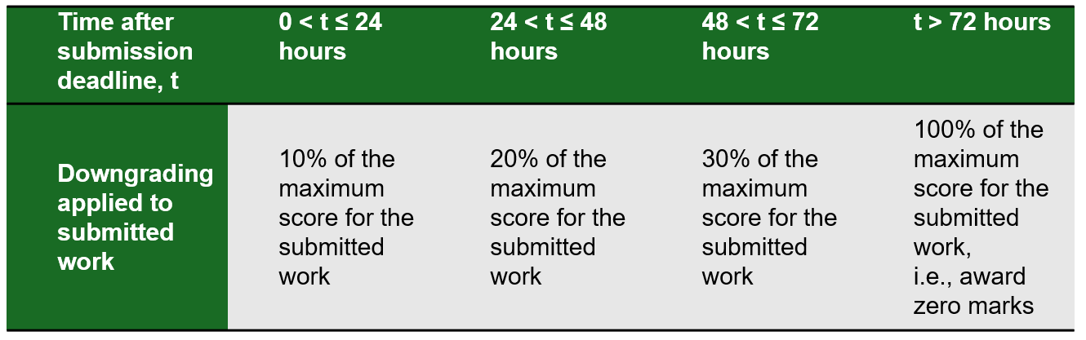
Administrative Matters
Penalties will be applied for late submissions.

Slide 12
Submissions
Full GA released in Week 1
Interim submissions:
Part 1 Milestone 1 - Week 4, submit in POLITEMALL and SA3 system
Part 1 Milestone 2 - Week 7, submit in POLITEMALL and SA3 system
Final submission (Part 1 and 2), submit in POLITEMALL and SA3 system by Friday, 6 February 2025, 11:59 PM (2359H)
Note:
Interim submissions may consist of each member’s individual parts if not yet integrated.
All students should submit either their own individual part(if not yet integrated), or the integrated project.

Slide 13
Recommendations
You may submit your work in progress at any time before the submission deadlines for this assignment.
Do not wait till the last hour or minute to submit your work.
It is your responsibility to make regular backups of your work both on POLITEMALL and on your own HDD/thumb drives.

Slide 14
Graded Assignment Project Requirements Discussion
Refer to C372 Graded Assignment.pdf for detailed project requirements

Slide 15
Graded Assignment Project Requirements
Reminder on the documents to be downloaded:
C372 Graded Assignment
C372 Graded Assignment Briefing
C372 Graded Assignment Report – Team X
C372 Individual Declaration of Compliance - STUDENTID - STUDENTNAME
C372 Individual Graded Assignment AI Interaction Journal - STUDENTID – STUDENTNAME
C372 Individual Graded Assignment AI Interaction Journal - SAMPLE
Note:
The highlighted will form part of your final deliverable submissions.

Slide 16
Questions?

